Slide 1
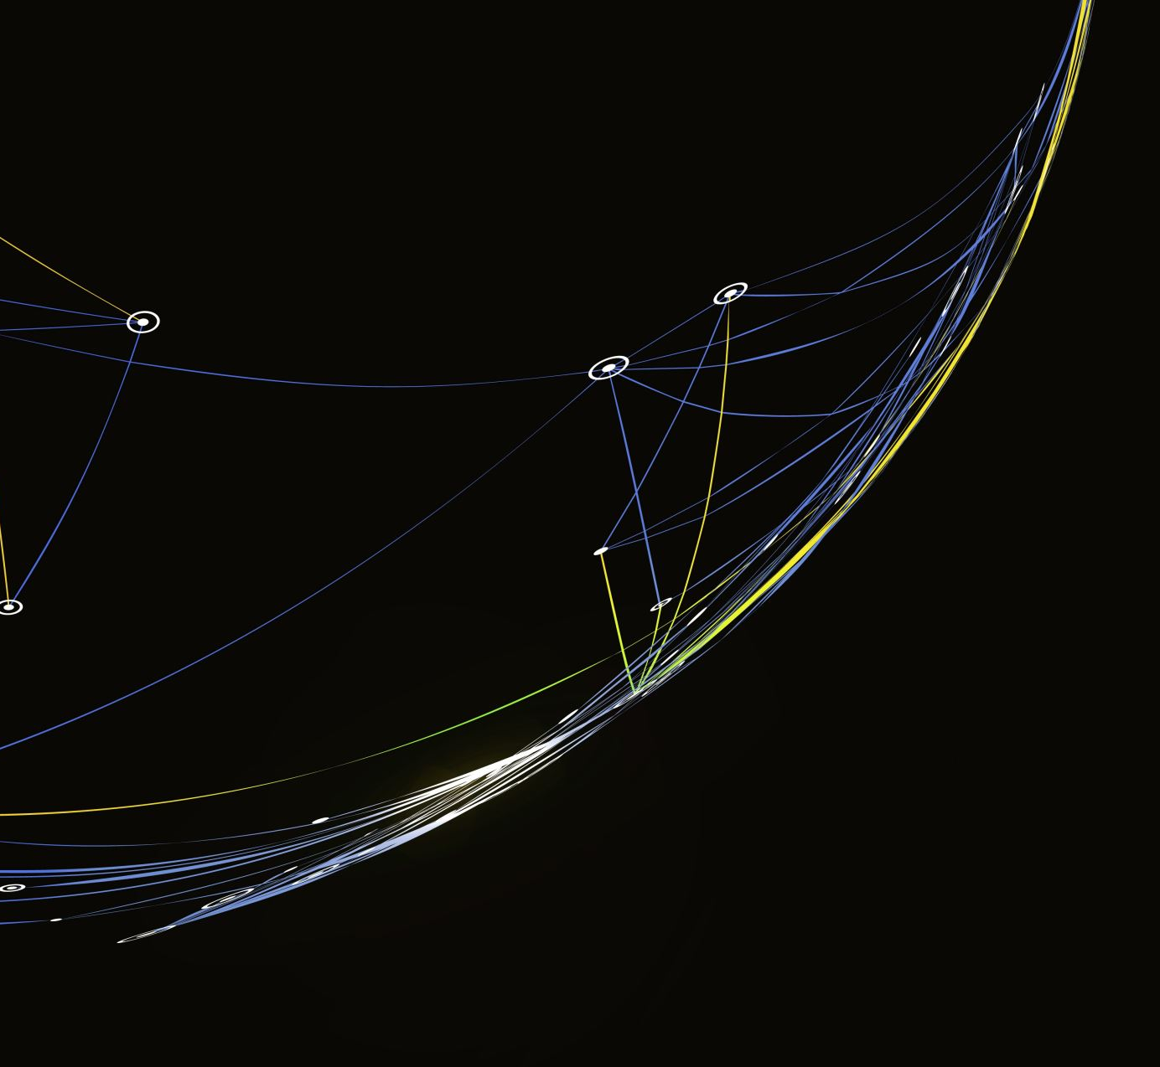
Spain Electricity Shortfall Challenge
Team 14

Slide 2

Table of Contents:
Introduction
Problem Statement
Data pre-processing
Eda
Models
Conclusion

Slide 3

Introduction :
1.We’ve have been tasked to model the shortfall between the energy generated by means of fossil fuels and various renewable resources.
2.The government of Spain is considering an expansion of its renewable energy resource infrastructure investments.
3.As such they require information on the trends and patterns of the country’s renewable sources and fossil fuel energy generation .

Slide 4


Problem Statement:
Tasked to model the shortfall between energy generated by fossil fuels and renewable sources for the country of Spain.
Energy Generated
Fossil Fuel
Renewable Sources
Shortfall

Slide 5
Data Preprocessing:
Imputed the Valencia_pressure with median to remove the NaN values.

Slide 6

Exploratory Data Analysis (EDA):
Understanding the dataset.

Slide 8
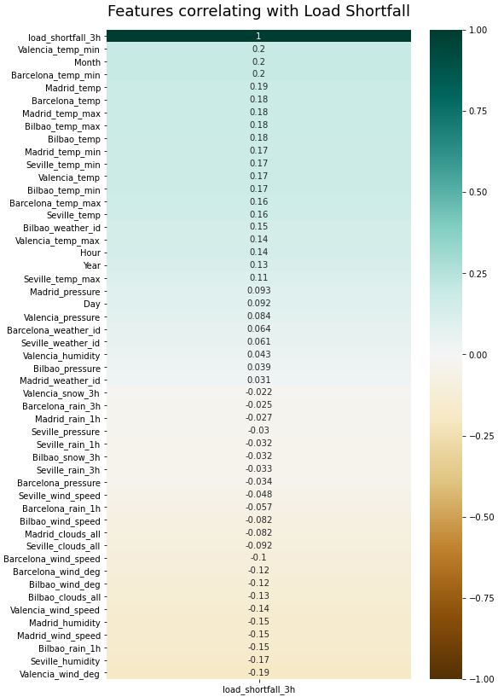
Features correlating with load Shortfall graph:
Positive
With the positive correlation the closer the feature is to 1, the more the shortfall will increase or decrease with the feature.
+
With the negative correlation the closer it is to -1, the greater the opposite affect of the feature will be on the shortfall. If feature increases, the shortfall will decrease.
-
Negative

Slide 9
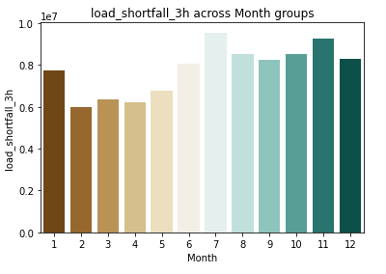
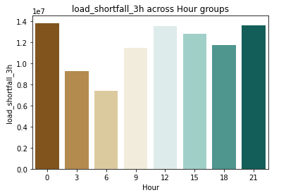
Month and hour Groups:
Month group shows us that the 1st month and last 6 months of the year have the most load shortfalls.
Hour Groups shows us that during the last 12 hours of the day the load shortfall occurs the most.

Slide 10

Data engineering
Creating regression models.

Slide 11
Devide Dataset:

Slide 12

Standardisation and why we used it:
Scaling technique that does not suffer from outliers and doesn’t contain it in a [0,1] range.
Why its important ?
Why not normalization ?
Suffer from outliers by squeezing data into [0,1] range making the bulk of the data lie in a small range.
Critical to regularisation which puts constraints on the size of the coefficients related to each variable.

Slide 13
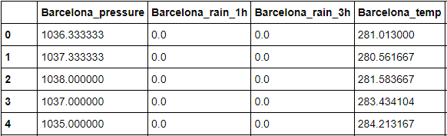
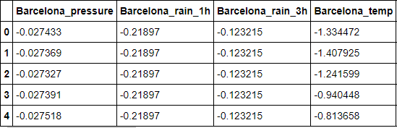
Data before and after stadardisation:
Before:
After:
Using standardisation we rescale all the features to fit on the same scale, to make the regularisation techniques more effective.

Slide 15

XGBregrssor (Extreme Gradient Boosting) :
We used XGBoost because of the Computation speed, Parallelization and Performance.
-
-

Slide 16

Model Performance:
Using RMSE to test the Model’s performance.

Slide 17
Root Mean Square Error (RMSE) :
Standard way to measure the error of a model in predicting quantitative data.
 | Decision Tree | Kneighbor- Regressor | Linear Regression | Ridge Regression | XGBooster Regressor
RMSE | 6187,231775 | 4765,006149 | 4848,569044 | 4841,212111 | 4361,639173
Decision Tree model had the highest RMSE, meaning the residuals are the furthest apart from the regression line.
The next 3 models have similar RMSE’s but still the most concentrated data.
Thus, we used the XGBooster which gives us the line of best fit.

Slide 18

Conclusion:

